Slide 1
Presentation Guidelines
You are free to structure your presentations to your liking, but students tend to have success with the following format.
Title Slide
Include the name of the Project and Group Members
Motivation & Summary Slide
Define the core message or hypothesis of your project.
Describe the questions you asked, and why you asked them
Describe whether you were able to answer these questions to your satisfaction, and briefly summarize your findings
Questions & Data
Elaborate on the questions you asked, describing what kinds of data you needed to answer them, and where you found it
Data Cleanup & Exploration
Describe the exploration and cleanup process
Discuss insights you had while exploring the data that you didn't anticipate
Discuss any problems that arose after exploring the data, and how you resolved them
Present and discuss interesting figures developed during exploration, ideally with the help of Jupyter Notebook
Data Analysis
Discuss the steps you took to analyze the data and answer each question you asked in your proposal
Present and discuss interesting figures developed during analysis, ideally with the help of Jupyter Notebook
Discussion
Discuss your findings. Did you find what you expected to find? If not, why not? What inferences or general conclusions can you draw from your analysis?
Post Mortem
Discuss any difficulties that arose, and how you dealt with them
Discuss any additional questions that came up, but which you didn't have time to answer: What would you research next, if you had two more weeks?
Questions
Open-floor Q&A with the audience

Slide 2
Presentation Requirements
The presentation requirements for Project 1 are as follows.
Your presentation must:
Be at least 8-10 min. long
Describe the core message or hypothesis for your project.
Describe the questions you and your group found interesting, and what motivated you to answer them
Summarize where and how you found the data you used to answer these questions
Describe the data exploration and cleanup process (accompanied by your Jupyter Notebook)
Describe the analysis process (accompanied by your Jupyter Notebook)
Summarize your conclusions. This should include a numerical summary (i.e., what data did your analysis yield), as well as visualizations of that summary (plots of the final analysis data)
Discuss the implications of your findings. This is where you get to have an open-ended discussion about what your findings "mean".
Tell a good story! Storytelling through data analysis is no different than in literature. Find your narrative and use your analysis and visualization skills to highlight conflict and resolution in your data.

Slide 3
Technical Requirements
The technical requirements for Project 1 are as follows.
Use Pandas to clean and format your data set(s)
Create a Jupyter Notebook describing the data exploration and cleanup process
Create a Jupyter Notebook illustrating the final data analysis
Use Matplotlib to create a total of 6-8 visualizations of your data (ideally, at least 2 per "question" you ask of your data)
Save PNG images of your visualizations to distribute to the class and instructional team, and for inclusion in your presentation
Optionally, use at least one API, if you can find an API with data pertinent to your primary research questions
Create a write-up summarizing your major findings. This should include a heading for each "question" you asked of your data, and under each heading, a short description of what you found and any relevant plots.

Slide 4
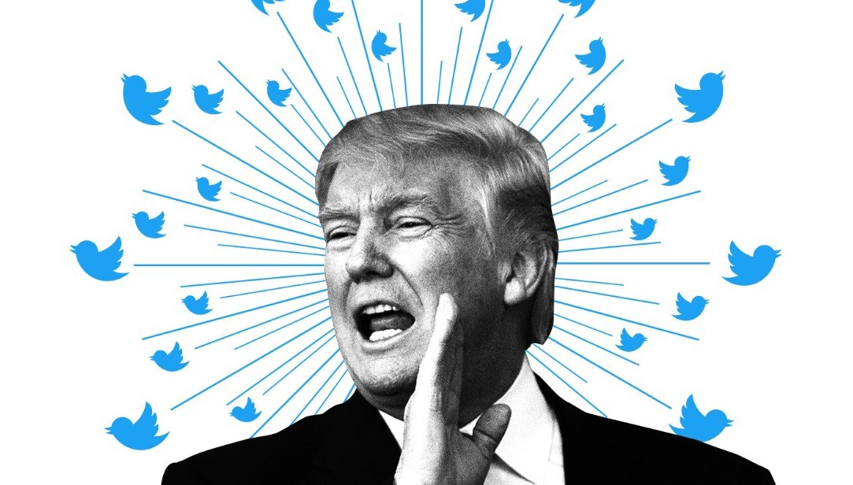
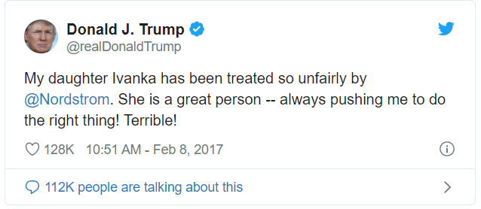
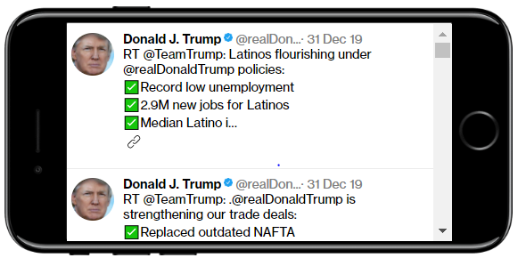
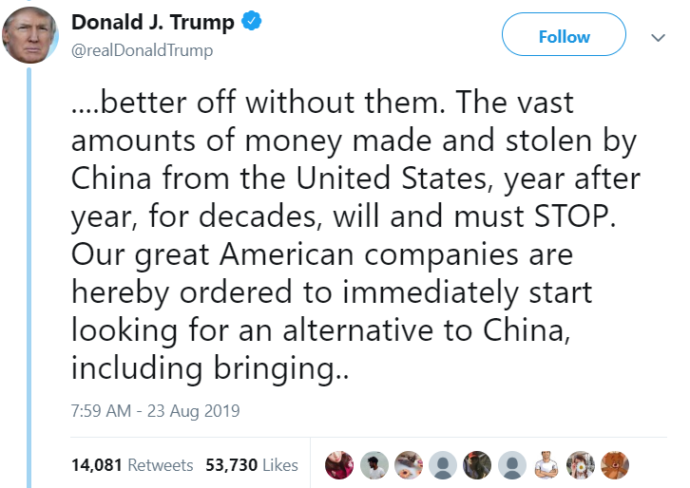
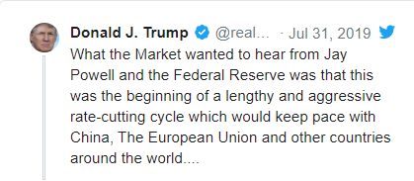
Trump, Tweets, and Trade !!!
Effect of Sentiment Signal from Trump on stock indices
The Team: Tweeter Diviners
Chris Simmons - Lead
Donatien Toni
Sreedevi Agasthya
Nirguna Joshi

Slide 5
Abstract, Motivation & Summary:
Abstract / Scope:
We are primarily analyzing president Trump’s tweets, how does it affects the stock market prices and figure out if there is any correlation between these two.
Motivation:
We always hear the buzz about the Trump tweets affect the market, it is believed to certain extent that there is a correlation between his tweets and the market prices
Everyday there are large amounts of tweets posted through twitter, around 6,000 tweets are tweeted on Twitter every second which corresponds to 500 million tweets per day
This large volume of data has been arguably providing valuable insights about public sentiments on various topics and has led to a recent growth in research of public’s sentiment and its relationship to financial markets.
Determining the public’s sentiment by retrieving online information on the market can be valuable in creating trading strategies.
Especially tweets from President Trump, it is believed to certain extent that there is a correlation between his tweets and the market prices
Although there are many debates around, if President Trump’s tweet is the background noise for markets or not!!! in this project we will manually mark the tweets posted by President Trump on the stock market and have a look at the market prices changes.
There might be plenty of reason why the stock market plunged but we will focus on our goal to see if President Trump’s tweet has any effect on the market.

Slide 6
Summary:
To achieve this, we broke down the scope into 4 tasks:
1. Tweet data Collection
We did the data mining of Trump tweets using Twitter API on daily basis for 4 years starting from 2016 to 2019.
2. Stock Market Data Collection – for Dow Jones, SPX and Forex.
Second, we retrieve the market prices from Stooq and process them for analysis. We did collect the data for Dow Jones, SPX and Forex.
3. Data clean up, Streamline Tweet Collection With A Tag (For Sentimental analysis)
We transformed collected daily data into, weekly, monthly and yearly to make use of it into our analysis. we manually marked down the tweets that contains texts which affected the stock market the most ( positive and negative words)
4. Data Visualization and Tweet- Stock Correlation
Finally, we combined all the required data and visualize our findings
Conclusion.

Slide 7
Task Details:
1. Tweet data Collection
Depending on the request the API sends us a list of JSON/Twitter lists response that contains tweets data.
This contains information such as username, location, time stamp, full texts tweeted etc. for the current requirement purpose of visualization, we focused mainly on the device used, full tweet text, tweet id, time stamp of Trump tweets.
Note: To access twitter API we need API Key for authentication. Once the API key is created we can easily access the API.
API used: XXXX
Code Details: attach the code file (Python, Padas and Matplotlib)
CSV file generated for the Trump Tweet:

Slide 8
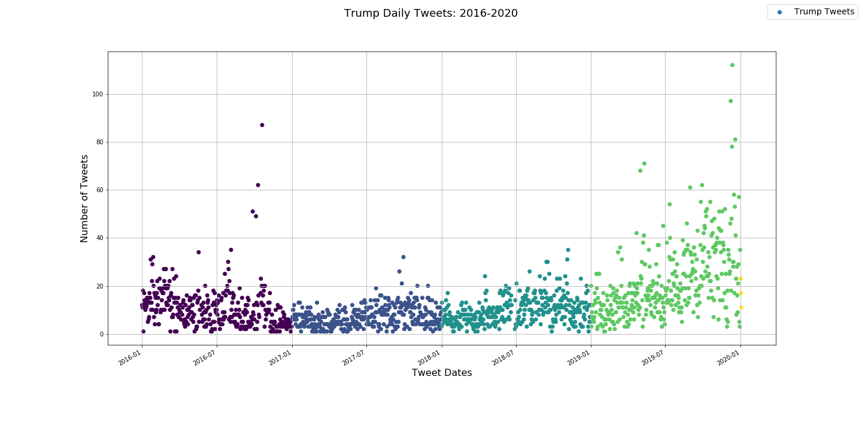
1. Tweet data Collection: Continued….
Created the below visualization plots to get deeper insights of the tweets collected. We used Matplotlib for visualizing the tweet data: plotted down for 2016 to 2019 and for 2019
Need graph for 2019 alone

Slide 9
2. Stock Market Data Collection – for Dow Jones, SPX and Forex.
After analyzing the tweet data separately, we collect the stock market data for Dow Jones, SPX and Forex data for the duration starting from 2016 to 2019. To do this, we used the below API to gather data for the duration of trading day.
API used for the stock market data collection: Stooq
CSV file generated for the Stock market data:
Code Details: attach the code file (Python, Padas and Matplotlib)
Output of the Dow Jones, SPX and Forex looks like this: provide couple of images

Slide 10
2. Stock Market Data Collection – for Dow Jones, SPX and Forex – Continued……
Created the below visualization plots to get deeper insights of the tweets collected. We used Matplotlib for visualizing the tweet data: plotted down for 2016 to 2019 and for 2019
Need Dow jones, SPX and Forex only pictures

Slide 11
3. Data clean up, Streamline Tweet Collection With A Tag (For Sentimental analysis – words which kicked the market)
After we collected the Tweet and Stock market data, we cleaned the data and made in such way that it helps in making the correlation with visualization.
We used both excel and pandas to clean the data. The available daily data is transformed into weekly, monthly and yearly for visualization purpose.
Tweet tagging is made by selecting the top 5 words from Trump tweet which moved the market most and the reason we are tagging is because we need a way to look for correlation between the tweets and the stock prices.
We manually tagged the tweet text by choosing the top 5 words, but if interested you can create a machine learning model to use specific emotions for sentiment classification or examine specific words from tweets that are associated with changes in stock prices., a technique that greatly reduces manual tweet tagging.
Cleaned csv file, OP from Pandas:
Code Details: attach the code file (Python, Pandas and Matplotlib)

Slide 12
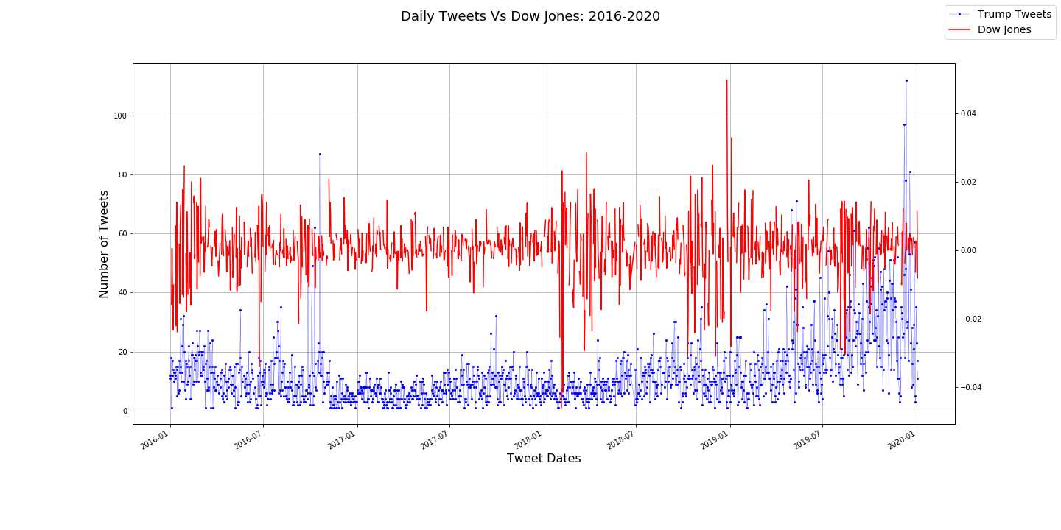
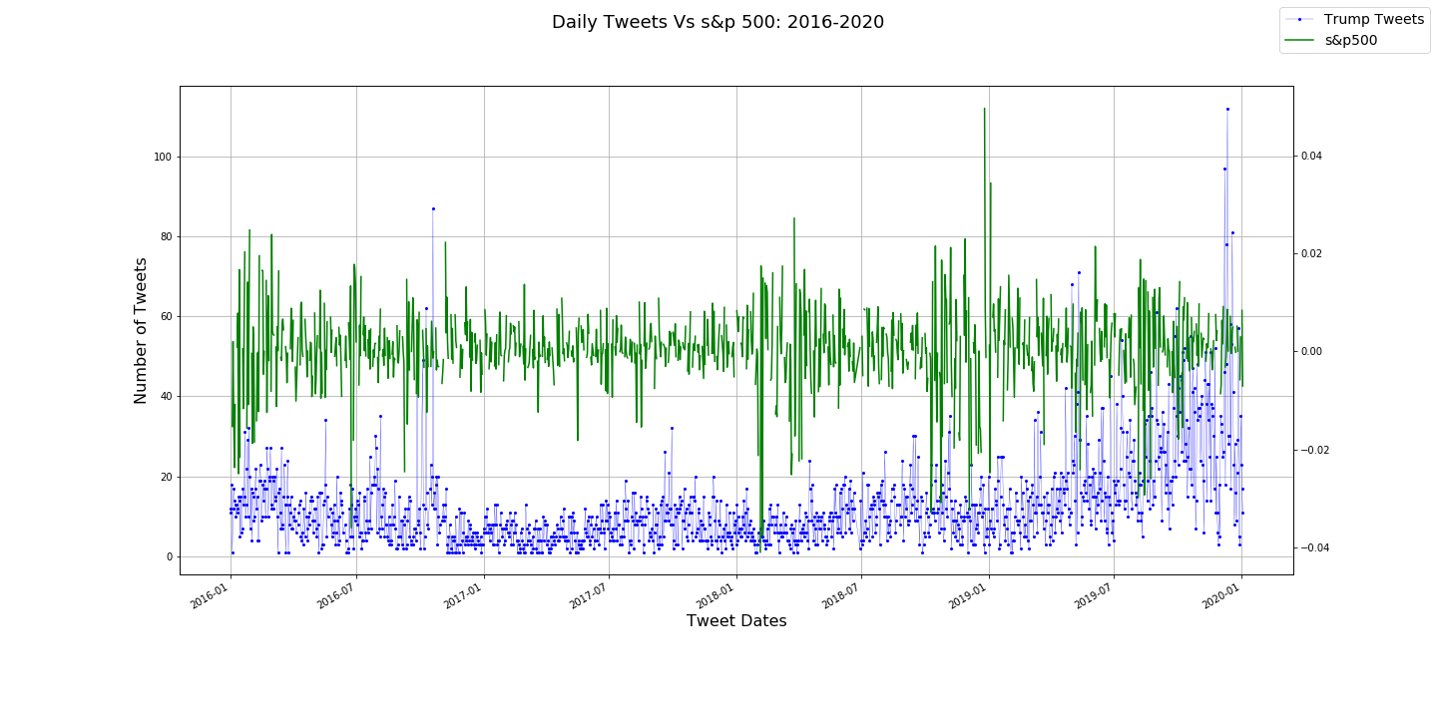
Data Cleaning and plots for Daily Tweets Vs Dow Jones & SPX from 2016 to 2020

Slide 13
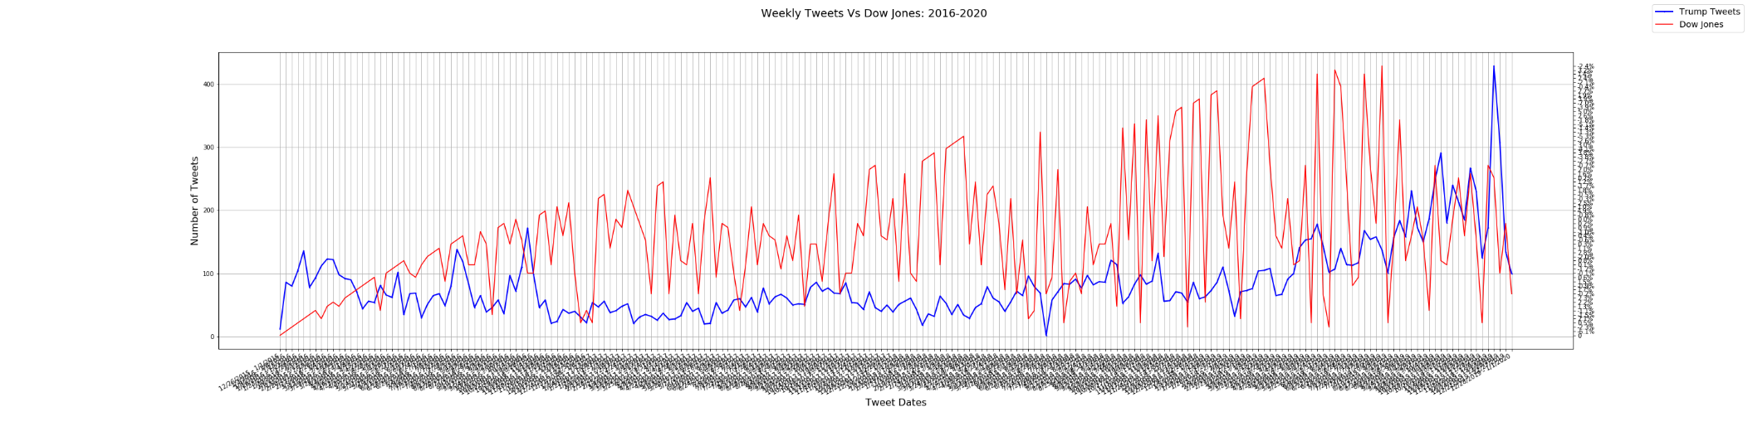
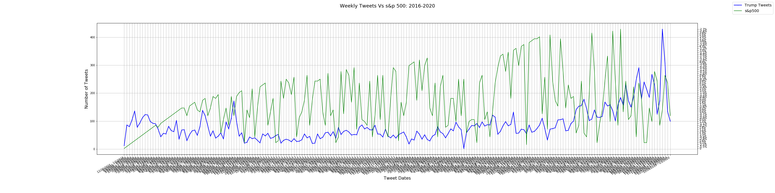
Data Cleaning and plots for weekly Tweets Vs Dow Jones & SPX from 2016 to 2020

Slide 14
Data Cleaning and plots for Monthly Tweets Vs Dow Jones & SPX from 2016 to 2020

Slide 15
Data Cleaning and plots for Yearly Tweets Vs Dow Jones & SPX from 2016 to 2020

Slide 16
4. Data Visualization and Tweet- Stock Correlation
The final step after tagging for correlation would be to combine both the data sets and come up with a visualization that shows us the correlation between the tweets and the stock market variation.
Used Matplotlib for data visualization.
Images for correlation Between Tweets and Stock Prices:
With this, we see there is a correlation between President Trump’s tweet and stock market prices.
For example, Get couple example of 2019 Tweet where the variation is observed and explain the same.

Slide 17
Daily Tweets Vs Dow Jones for 2019

Slide 18
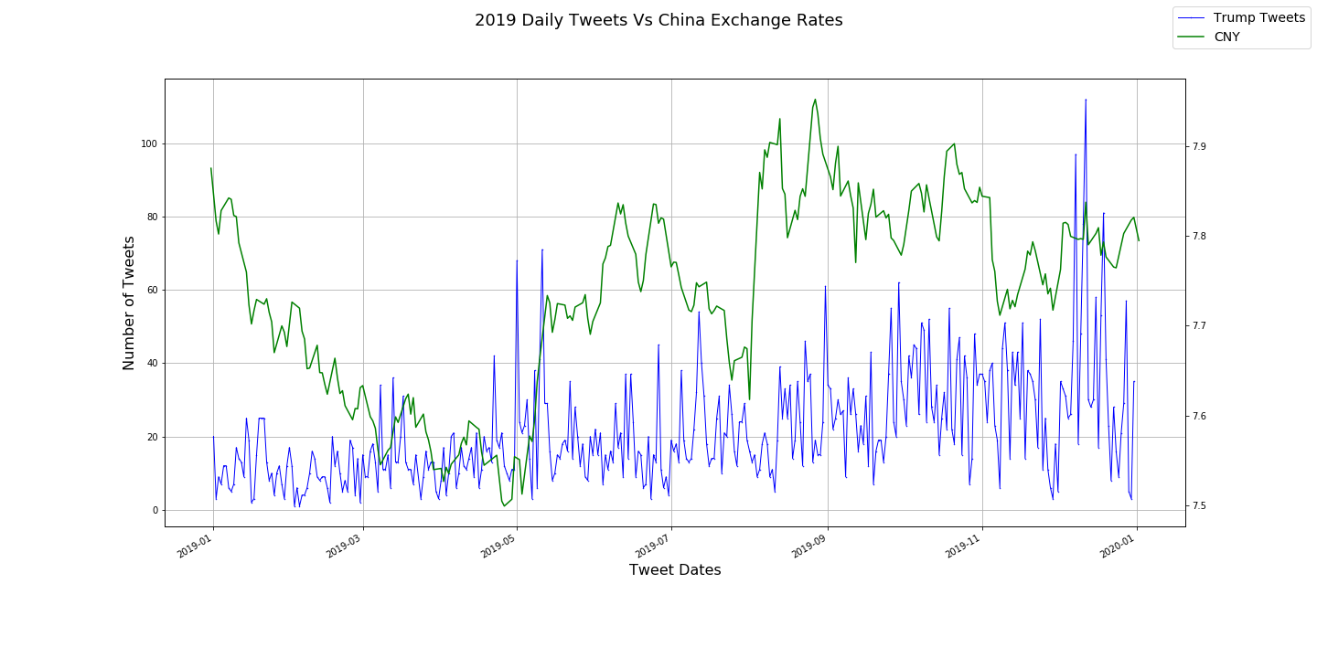
Daily Tweets Vs China Exchange Rates for 2019

Slide 19
Conclusion:
The scope of our analysis was to analyze and visualize the correlation between the tweets and stock market prices by manually marking the correlation tags.
Looking at the correlation between the Tweet and the market movement, we can say that the Trump Tweet definitely affect the market.
In almost every case, when the president unleashes his Twitter (TWTR) fury, the share price of the affected company drops—in some cases fairly significantly. Lockheed Martin’s stock (LMT), for example, plunged by more than 5% in December, after Trump criticized the company by saying the cost of its F-35 jet aircraft contract was “out of control.”
Even Nordstrom (JWN), which Trump attacked just a few weeks ago after the company removed his daughter Ivanka’s fashion designs from their stores, has increased in value since the attack.

Slide 20
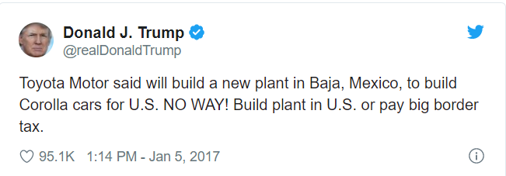
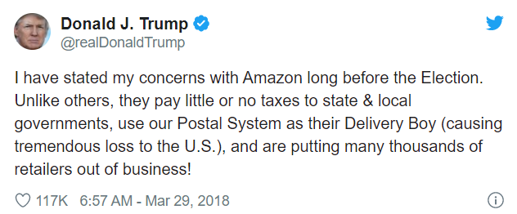
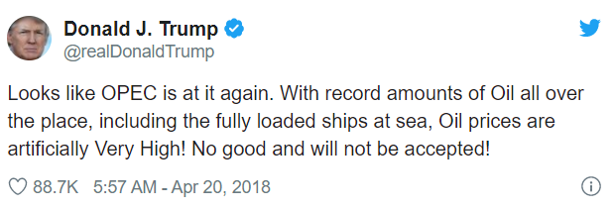
Conclusion:
As a result, the company stocks lost almost US$1.2 million in market cap in just 5 minutes of the tweet being uploaded. Over the next few months, the stock continued its downward spiral, losing a total of $12 billion in market cap.
resulting in high volatility in Amazon’s shares, which fell over 3.8% in the next session. It is interesting to note that a subsequent positive tweet on April 3, 2018, led to an increase in the share price by 1.4%. Amazon suffered losses of £35.5 billion in market cap as a result of this.
Within minutes of his tweet, The Brent crude price fell 0.6%, while WTI fell 0.7%.

Slide 21
Scope of Improvement:
It would be an interesting area of future studies to naturally train a neural network model with words and sentiments that seem to correlate to changes in stock prices. In which case we might be able to see stronger correlation of words with stock prices variation.
We can create a machine learning model to use specific emotions for sentiment classification or examine specific words from tweets that are associated with changes in stock prices., a technique that greatly reduces manual tweet tagging.
We also need to include sentimental analysis, Twitter Sentiment Analysis, also known as Opinion Mining, is primarily for analyzing conversations, opinions, and sharing of views (all in the form of tweets) for deciding business strategy, political analysis, and also for assessing public actions

Slide 22
Sources: (Datasets)
https://towardsdatascience.com/trump-tweets-and-trade-96ac157ef082
https://medium.com/@chitu_rk/does-president-trumps-tweet-has-any-correlation-with-stock-market-prices-769ae0fba203
https://www.toptal.com/python/twitter-data-mining-using-python
https://www.digitalvidya.com/blog/twitter-sentiment-analysis-introduction-and-techniques/
https://www.digitalvidya.com/blog/sentiment-analysis/
https://www.barrons.com/articles/donald-trump-twitter-stock-market-51567803655
https://stooq.com/t/
http://www.trumptwitterarchive.com/
https://medium.com/swlh/analyzing-trumps-tweets-5368528d2c90

Slide 23
Q & A, Thank you,

